Slide 1
Deep Learning and Object Detection
Snehal Jadhav

Slide 2
What is Deep Learning?
Deep learning is a machine learning technique that teaches computers to do what comes naturally to humans.
Basically, deep learning mimics the way our brain functions i.e. it learns from experience.

Slide 3
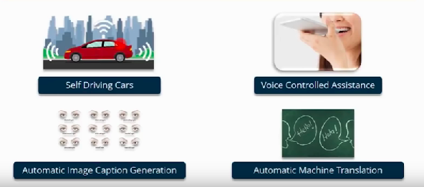
Applications of Deep Learning
With the help of Deep Learning MIT is trying to predict the future.

Slide 4


Machine Learning
Features: | Tomato | Cherry
Size
Type of stem
Colour

Slide 5
Machine Learning Limitation.
One of the biggest challenge with traditional ML models is a process called feature extraction.
ML algorithms are not useful while working with high dimensional data, that is where we have large number of inputs and outputs.

Slide 6
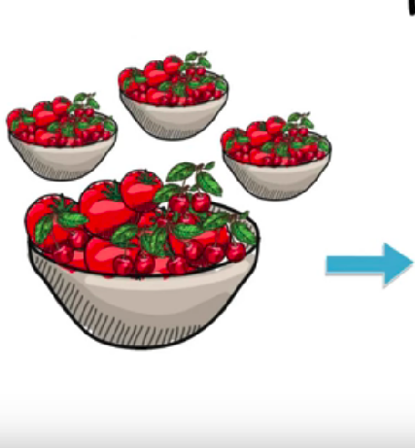
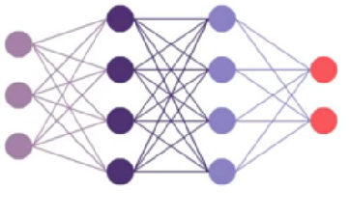
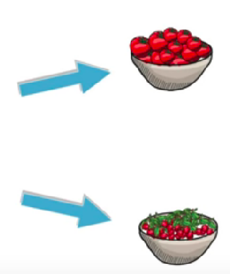
Deep Learning

Slide 7
Deep Learning to the Rescue
Deep Learning models are capable to focus on the right feature by themselves, requiring little guidance from the programmer.
These models also partially solve the dimensionality problem.

Slide 8
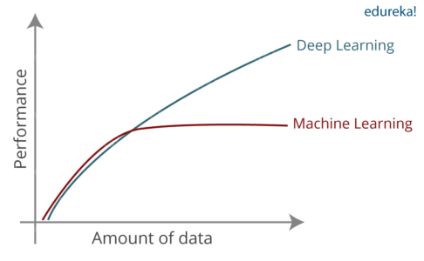
Performance and Amount of Data Ratio:

Slide 9
How Deep Learning Works
The idea behind deep learning is to build learning algorithm that mimic brain.
Deep learning is implemented with help of Deep Networks. Deep Networks are nothing but neural network with multiple hidden layer.

Slide 10
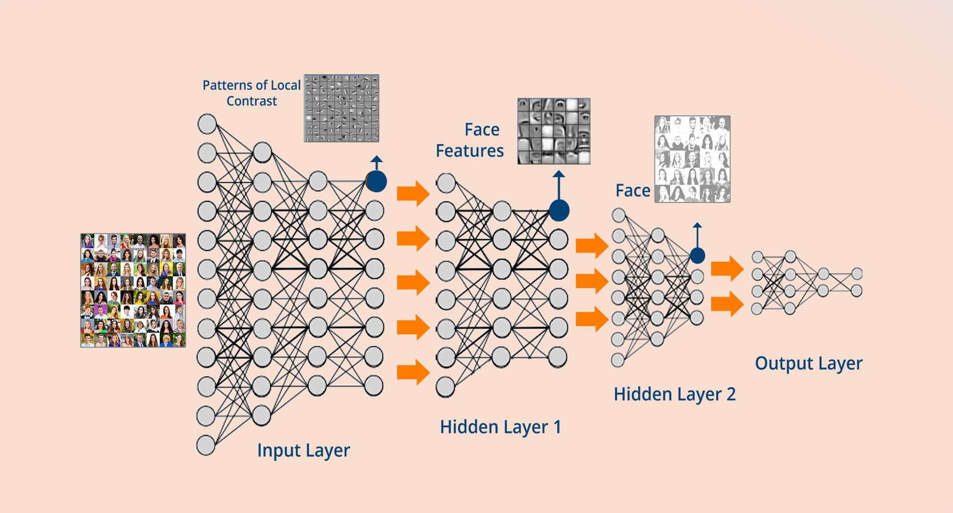
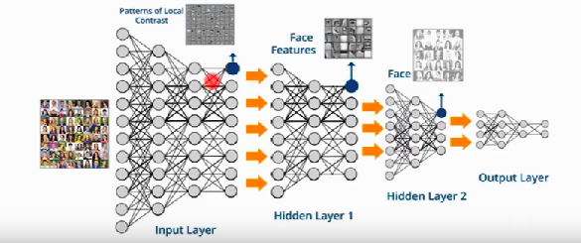

Slide 11
Object Detection

Slide 12
What is Object Detection?
Object Detection is the process of finding real-world object instances like car, bike, TV, flowers, and humans in picture, video or a webcam feed.
Object Detection is used almost everywhere these days.

Slide 13
Applications Object Detection
Face Recognition
People Counting
Industrial Quality Check
Self Driving Car
Security(Banking and Technology)

Slide 14
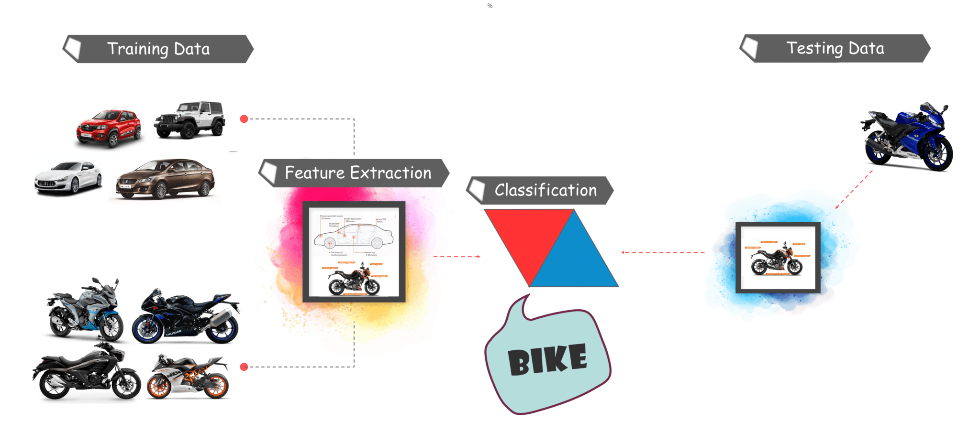

Slide 15
Object Detection Models
R-CNN.
Fast R-CNN.
Faster R-CNN.
Mask R-CNN.
SSD (Single Shot MultiBox Detector)
YOLO (You Only Look Once)
Objects as Points.

Slide 16
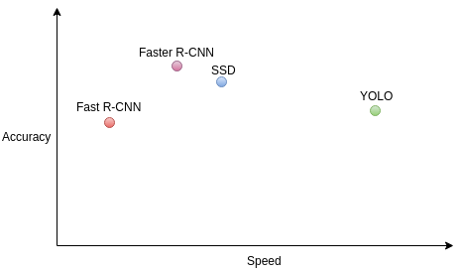
Speed vs Accuracy trade-off:

Slide 17
Object Detection Demo
Tensorflow
COCO API -(Common Object in Context)
Model-SSD: Single Shot MultiBox Detector

Slide 18
Single Shot MultiBox Detector
The SSD object detection composes of 2 parts:
Extract feature maps, and
Apply convolution filters to detect objects.
Single Shot MultiBox Detector reached new records in terms of performance and precision for object detection tasks, scoring over 74% mAP (mean Average Precision) at 59 frames per second on standard datasets such as PascalVOC and COCO.

Slide 19
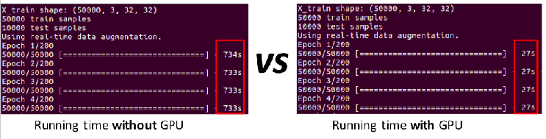
GPU - Graphical Processing Units
GPUs are made to do common parallel problems fast.
All similar calculations are done at the same time. This extremely boosts the performance in parallel computations.

Slide 20
Limitation of Deep Learning
While deep learning is the most efficient way to deal with unstructured data, neural networks require a mass volume of data to train.
Deep neural networks take hours or even months to train. The time increases with the amount of data and number of layers in the network.
Training a neural network requires graphical processing units which have thousands of cores as compared to CPUs and GPUs, of course, are more expensive

Slide 21
Questions?

Slide 22
thank you

